Slide 1

Clean Energy Awareness Toolkit: Empowering Local Communities
Empowering rural communities with knowledge and tools to harness renewable energy. This toolkit aims to bridge the education gap and foster sustainable practices.
PA
by Pilli Anusha

Slide 2
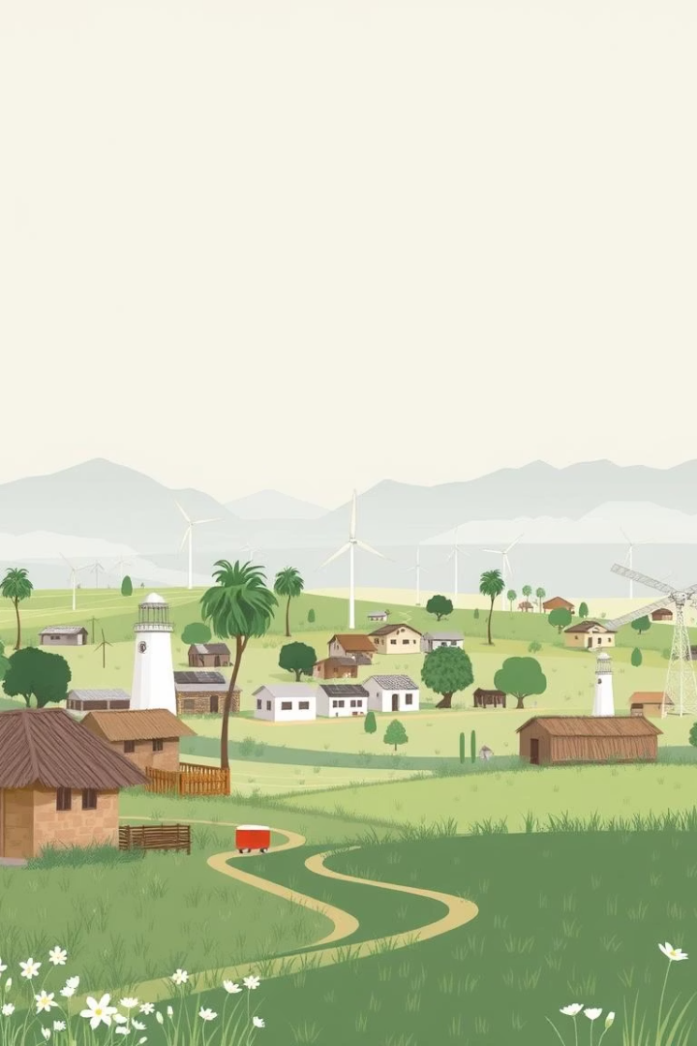



The Challenge: Renewable Energy Education Gap in Rural Areas
Lack of Awareness
Education Gap
Many rural communities are unaware of renewable energy benefits.
Limited access to information hinders adoption and understanding.
Economic Barriers
High upfront costs deter sustainable energy investment.
Rural areas often face significant hurdles in adopting clean energy solutions. Insufficient knowledge and financial constraints prevent communities from embracing vital renewable resources.

Slide 3




Our Solution: A Comprehensive Awareness Toolkit
Informative Guides
Easy-to-understand materials on clean energy basics.
Community Workshops
Interactive sessions for hands-on learning and discussion.
Practical Resources
Tools for assessing local energy needs and potential.
Our toolkit provides a multi-faceted approach to education. It combines accessible information with practical, engaging activities to foster understanding and adoption.

Slide 4
Toolkit Components: Resources, Workshops, and Community Engagement
Educational Modules
Workshop Facilitation
Community Initiatives
Interactive online and offline learning content. Covers solar, wind, and hydro power basics.
Training for local leaders to conduct energy awareness sessions. Focuses on practical application and benefits.
Support for local projects and demonstration sites. Encourages collective action and shared success.
Beginner-friendly guides
Hands-on activities
Pilot project funding
Case studies from similar regions
Q&A sessions
Success story sharing
The toolkit integrates diverse elements to ensure comprehensive learning and community involvement. From detailed modules to practical workshops and collaborative projects, every aspect supports clean energy adoption.

Slide 5
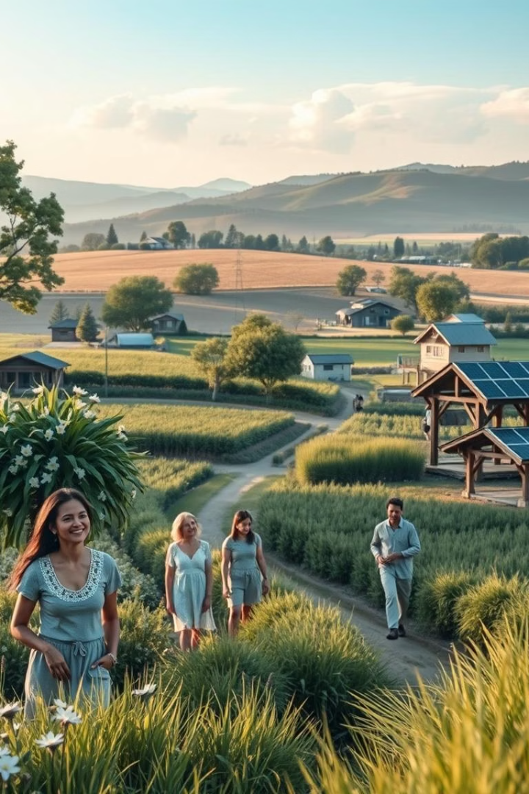
Impact & Sustainability: Building a Greener Future Together
Increased Adoption
Economic Benefits
More households transition to renewable energy sources.
Lower energy bills and new green job opportunities.
Environmental Health
Reduced carbon emissions and improved air quality.
Our toolkit fosters a ripple effect of positive change. It leads to greater renewable energy adoption, bringing economic prosperity and environmental benefits to communities.

